Slide 1

Review Course

Slide 2
Objectives
Review course
Course review

Slide 3
Importing Datasets
Analyze Python data using a dataset
Identify three Python libraries and describe their uses
Read data using Python's Pandas package
Demonstrate how to import and export data in Python
Course review

Slide 4
Data Wrangling
Pre-processing Data in Python
Describe how to handle missing values
Describe data formatting techniques
Describe data normalization
Demonstrate the use of binning
Demonstrate the use of categotical variables
Course review

Slide 5
Data Wrangling
Describe data normalization
Demonstrate the use of binning
Demonstrate the use of categotical variables
Course review

Slide 6
Exploratory Data Analysis
Exploratory Data Analysis
Implement descriptive statistics
Demonstrate the basics of grouping
Describe data correlation processes
Describe data correlation statistics
Describe why and how to apply the Chi-Squared test
Course review

Slide 7
Model Development
Describe how to process linear regression in Python
Apply model evaluation using visualization in Python
Apply polynomial regression techniques to Python
Describe the use of R-squared and MSE for in-sample evaluation
Apply prediction and decision making to Python model creation
Course review

Slide 8
Model Evaluation
Describe data model refinement techniques
Explain overfitting, underfitting and model selection
Apply ridge regression to regularize and reduce the standard errors to avoid overfitting a regression model
Apply grid search techniques to Python data
Course review

Slide 9
Lab1- Data Analysis with Python
Create a Jupyter notebook
Apply data analysis and modeling techniques to housing price data
Course review

Slide 10
Introduction to Data Visualization Tools
Describe the importance of data visualization
Relate the history of Matplotlib and its architecture
Apply Matplotlib to create plots using Jupyter notebooks
Read csv files into a Pandas DataFrame
Process and manipulate the data in the DataFrame
Generate line plots using Matplotlib
Course review

Slide 11
Basic and Specialized Visualization Tools
Explain how to generate an area plot using Matplotlib
Describe why and how to create histograms using Matplotlib
Explain how to create bar charts
Create pie charts using Matplotlib
Create a box plot using Matplotlib
Explain how to generate an Scatter plot using Matplotlib
Course review

Slide 12
Advanced Visualizations and Geospatial Data
Apply advanced visualization tools to create waffle charts
Create word clouds.
Use Seaborn with Matplotlibto generate attractive regression plots.
Explain how to use the Folium, for visualizing geospatial data.
Use Folium to create maps and superpose markers.
Create Choropleth Maps with Folium.
Course review

Slide 13
Creating Dashboards with Plotly and Dash
Identify high-level popular Python dashboarding tools.
Demonstrate basic Plotly, Plotly.graph_objects, and Plotly express commands.
Demonstrate using Dash and basic Dash components (core and HTML).
Course review

Slide 14
Creating Dashboards with Plotly and Dash
Demonstrate adding different dashboard elements including text boxes, dropdown, graphs, and others.
Apply interactivity to dash core and HTML components.
Describe how a dashboard can be used to answer critical business questions.
Course review

Slide 15
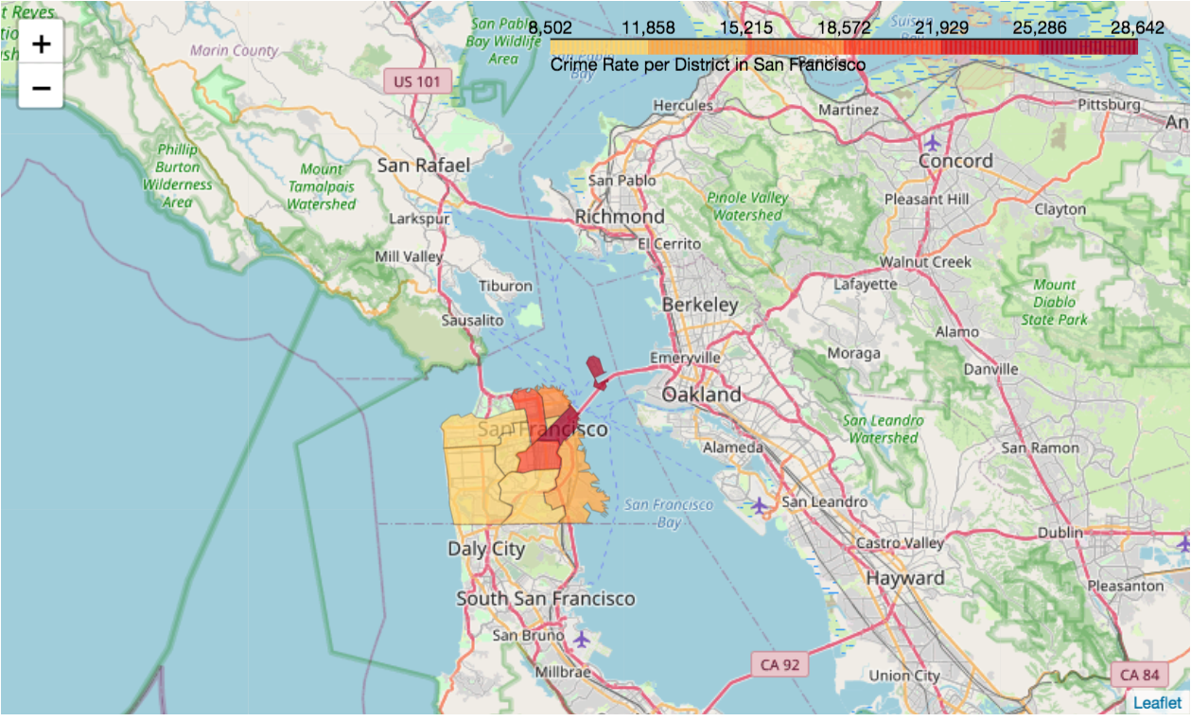
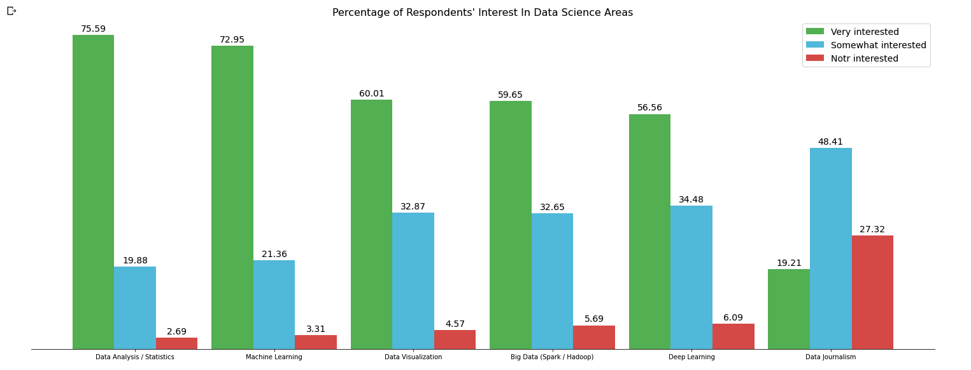
Lab2, lab3- Data Visualization with Python
Apply the knowledge learned to perform statistical analysis of data
Represent statistical data in the form of visualization
Implement by Python language
Course review

Slide 16
Building AI Applications with Watson APIs- Introduction
Describe the technologies involved in the creation of AI applications
Activate Trial Account (review)
Create Watson services instances on IBM Cloud
Creating a Chatbot with Watson Assistant
Course review

Slide 17
Building AI Applications with Watson APIs- Giving it a Voice
Discuss the pros and cons of various voice chatbot options
Understand how Watson Speech APIs work
Discuss the pros and cons of various voice chatbot options
Understand how Watson Speech APIs work
Integrate Watson Assistant and Watson Text to Speech and Speech to Text services
Course review

Slide 18
Building AI Applications with Watson APIs- Deployment
Discuss deployment options for chatbots built with Watson Assistant
Deploy a Watson Assistant chatbot to Facebook Messenger
Course review

Slide 19
Create Db2 service instance
Use IBM cloud account to create and use resources
Create an instance of a Db2 service
Course review

Slide 20
Load data into Db2
How to use a DB2 service
How to upload documents to a DB2 service.
Course review

Slide 21
Setup server to provide REST API
Setup server to provide REST API
How to integrate Db2 data with the chatbot.
Course review

Slide 22
Lab 4-Create Student Advisor Chatbot with Watson Assistant and Db2
How to integrate Db2 data with the chatbot using webhook.
Apply your knowledge to the creation of a chatbot that leverages Watson Assistant and DB2
Course review

Slide 23
Applied Data Science Capstone-Introduction
Project Scenario and Overview
IBM Project Creation in Watson
Link GitHub to Watson Studio
Understand how to connect Watson Studio account with GitHub
Publish Watson Notebook on GitHub.
Add Notebook to Watson.
Import a Jupyter notebook in a Watson Studio Project
Perform the tasks in the Jupyter notebook
Course review

Slide 24
Applied Data Science Capstone-Collecting the Data
Data Collection Overview
Implement the Data Collection API
Data Collection with Web Scraping
Implement the Data Collection with Web Scraping
Course review

Slide 25
Applied Data Science Capstone-Data Wrangling
Data Wrangling Overview
Introduce dataset columns
Implement data wrangling
Student complete the missing code
Course review

Slide 26
Interactive Visual Analytics and Dashboard
Calculate distances on an interactive map by writing Python code using the Folium library
Generate interactive maps, plot coordinates, and mark clusters by writing Python code using the Folium library
Build an interactive map to analyze the launch site proximity with Folium.
Course review

Slide 27
Interactive Visual Analytics and Dashboard
Build an interactive dashboard that contains pie charts and scatter plots to analyze data with the Plotly Dash Python library
Build a dashboard to analyze launch records interactively with Plotly Dash.
Course review

Slide 28
Predictive Analysis (Classification)
Predictive Analysis Overview.
Standardize the data.
Split the data into training testing data.
Train different classification models.
Hyperparameter grid search.
Course review

Slide 29
Predictive Analysis (Classification)
Use your machine learning skills to build a predictive model to help a business function more efficiently.
Testing differences mode:
  Logistic Regression
  Support Vector machines,
  Decision Tree Classifier
  K-nearest neighbors
Course review

Slide 30
Present Your Data-Driven Insights
Learn how to structure and build your data-findings report.
Explain the basic contents of the outline
Show some notes when making a present report
Course review

Slide 31
Lab5- Credit Card Fraud Detection
Implement Credit Card Fraud Detection model using SVM
Course review

Slide 32
Summary
Course review
Course review

Slide 33
Q & A
Course review

